Slide 1
Where Can I Find?
Al and Max

Slide 2
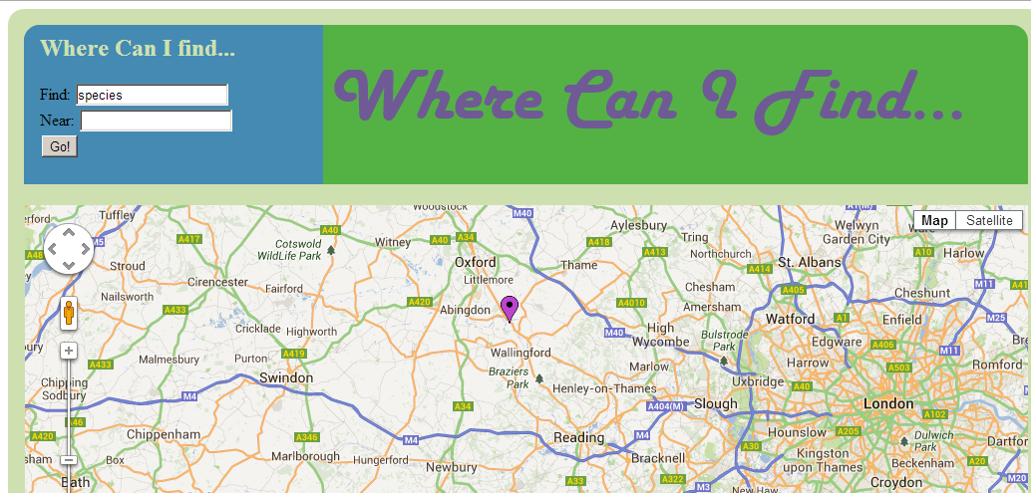
What is it?
A website aimed at wildlife enthusiasts and conservationist groups.
It allows users to identify the best nearby places to find different wildlife.

Slide 3
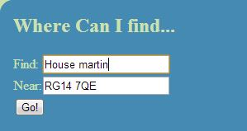
Function
- Through the Google maps API, we can tag a map the best nearby places to view a specific species.

Slide 4
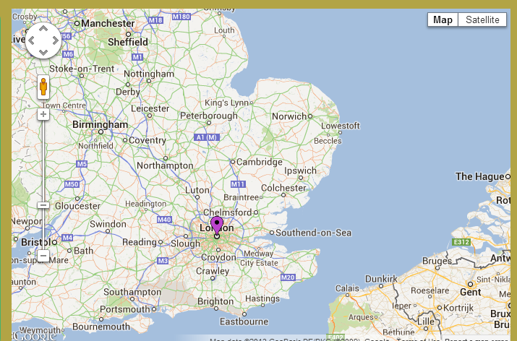
Open Data
- Google maps API to tag locations and to help visualise data

Slide 5
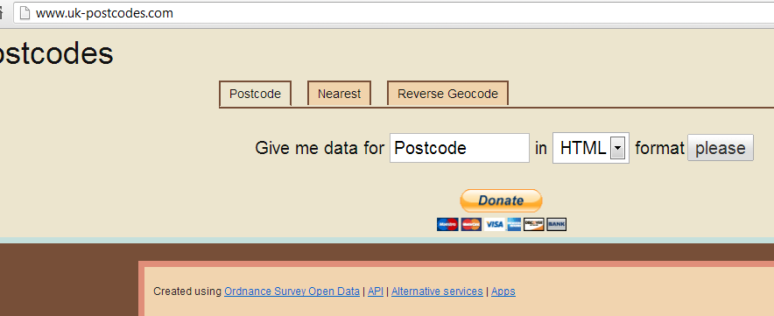
Open Data
An open API to convert postcodes into latitude and longitude
Uses open data from Ordnance Survey

Slide 6
User data
Our location finding is based on user submitted reports.
Allows users to see genuine data from those like them.

Slide 7
Website Structure
JS and HTML front end
PHP mediation
Python backend and API
SQL database

Slide 8

The future
Externally sourced reports – more open data
Our own open API for other parties

Slide 9
More Future
More social networking site style features: Images, user system.
Gamification

Slide 10
About Us
A team of two
Pre-YRS skills:
Max: Python, bit of HTML and java script
Al: Python, bit of C
Post YRS skills :
PHP, more HTML and JS, and SQL

Slide 11
Any questions?

